Slide 1
Computer Network and Network Design

Slide 2
Uses of Computer Networks
Network
A connected system of objects or people
Computer network
A collection of computers and other hardware devices connected together so users can share hardware, software, and data, and electronically communicate
Computer networks are converging with telephone and other communications networks
Networks range from small private networks to the Internet
In most businesses, computer networks are essential.

Slide 3
Networking Applications
The Internet
Largest computer network in the world
Telephone Service
POTS Network
One of the first networks
Still used today to provide telephone service to landline phones
Mobile Phones (wireless phones)
Use a wireless network for communications

Slide 4
Networking Applications
Cellular (cell) Phones
Must be within range of cell tower to function
Dual-mode Phones
Allow users to make telephone calls using more than one communications network
Cellular/Wi-Fi dual-mode phones can switch seamlessly between the Wi-Fi network and a cellular network
Satellite Phones
Communicate via satellite technology
Most often used by individuals such as soldiers, journalists, wilderness guides, and researchers

Slide 5
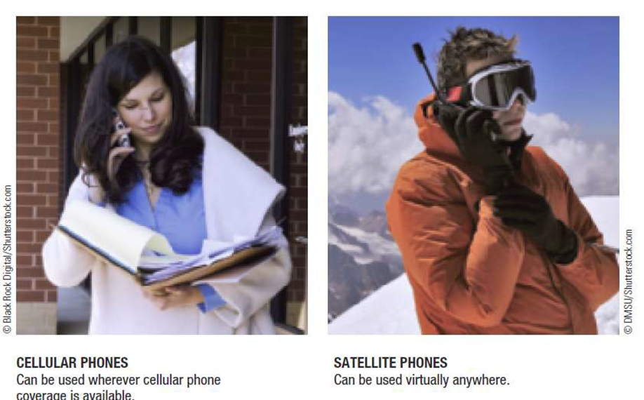

Slide 6
WHAT IS A NETWORK?
A computer network refers to a group of two or more computing devices that are connected by a communication medium allowing the computers to communicate electronically.
A computing device on a network is usually referred to as a node, being connected to one another, it allows nodes to exchange data with one another using a connection media between them.
The links can be established either over cable media such as wires or via a wireless media such as Wi-Fi.

Slide 7
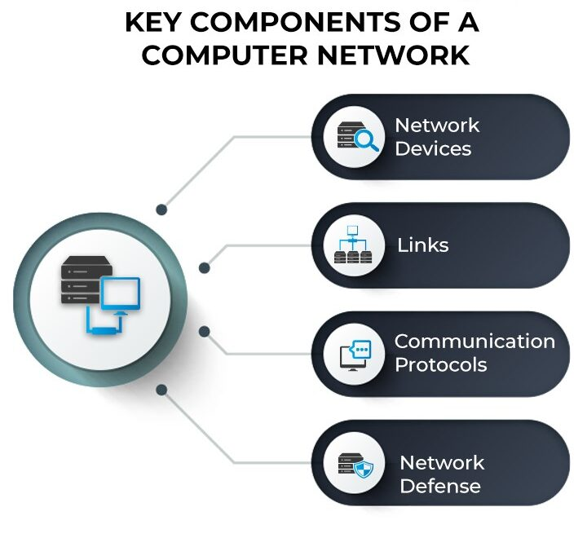

Slide 8
Key Components OF Computer Network
Network Devices - Hubs, Switch , Routers , Laptops/PC, Cables, Bridge
Links - Connecting Nodes
Communication Protocols - Rules and Protocols
Network Defence - Computer network defense refers to all the steps an organization can take in order to protect its computer network from unauthorized activity.
Malware basically just means “malicious software”.
Phishing (and spear phishing) is still one of the main ways hackers find their way into protected systems.
Firewall

Slide 9
Types of area networks
LAN covers the smallest area, MAN covers an area larger than LAN and WAN comprises the largest of all.
LAN or Local Area Network connects network devices in such a way that personal computers and workstations can share data, tools, and programs.
MAN or Metropolitan area Network covers a larger area than that covered by a LAN and a smaller area as compared to WAN.
WAN or Wide Area Network is a computer network that extends over a large geographical area, although it might be confined within the bounds of a state or country.

Slide 10
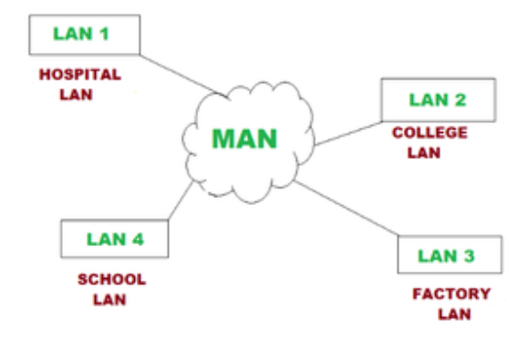

Slide 11
LAN (Local Area Network) –
Systems connected in a small network like in a building or a small office.
It is inexpensive.
It uses Ethernet or Token-ring technology.
Two or more personal computers can be connected through wires or cables acting as nodes.
Transfer of data is fast and is highly score.
Example -
Networking in home, office.
Networking between two computers.
Wi-Fi (When we consider wireless LAN)

Slide 12
MAN (Metropolitan Area Network) –
A network that can be connected within a city, for example, cable TV Connection.
It can be in the form of Ethernet, ATM, Token-ring and FDDI.
It has a higher range.
This type of network can be used to connect citizens with the various Organisations.
Example -
Campus Network is one of the perfect examples of MAN. Campuses usually have their buildings and branches distributed within a metropolitan area.Any campus will have a central administration building or headquarters. In this headquarters, servers host critical applications, databases, and collaborative platforms.
Cable TV Connection
Ethernet

Slide 13
WAN (Wide Area Network) –
A network which covers over a country or a larger range of people
Telephonic lines are also connected through WAN
Internet is the biggest WAN in the world
Mostly used by Government Organisations to manage data and information.
Example -
A bank, including its branch offices and ATM machines, is another example of an organization using a WAN. The branches may be in multiple U.S. states, or even global locations, but they are all linked through various secure connections. Both bank employees and customers are users.
Businesses with many international branch offices use a WAN to connect office networks together.

Slide 14
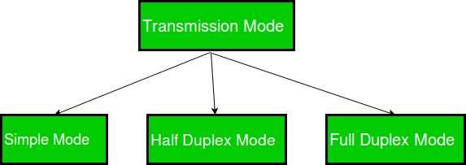
Direction of Data flow
Transmission mode means transferring data between two devices.
It is also known as a communication mode.

Slide 15

Simplex Mode
In Simplex mode, the communication is unidirectional, as on a one-way street. Only one of the two devices on a link can transmit, the other can only receive.
The simplex mode can use the entire capacity of the channel to send data in one direction.
Example: Keyboard and traditional monitors. The keyboard can only introduce input, the monitor can only give the output.

Slide 16
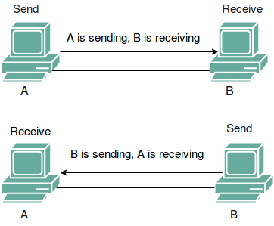
Half-Duplex Mode
In half-duplex mode, each station can both transmit and receive, but not at the same time.
When one device is sending, the other can only receive, and vice versa.
The half-duplex mode is used in cases where there is no need for communication in both directions at the same time.
Example: Walkie-talkie in which message is sent one at a time and messages are sent in both directions.

Slide 17
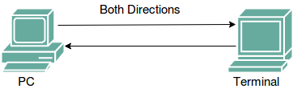
Full-Duplex Mode
In full-duplex mode, both stations can transmit and receive simultaneously.
In full_duplex mode, signals going in one direction share the capacity of the link with signals going in another direction.
Full-duplex mode is used when communication in both directions is required all the time. The capacity of the channel, however, must be divided between the two directions.
Example: Telephone Network in which there is communication between two persons by a telephone line, through which both can talk and listen at the same time.

Slide 18
Computer Network Components
NIC
Switch
Hub
Router
Modem
Cables
Twisted pair cable
Coaxial cable
Fibre-optic cable

Slide 19
Types of Connections
A network is two or more devices connected through a link.
A link is a communication pathway that transfers data from one device to another.
There are two possible types of connections:
Point-to-Point Connection
Multipoint Connection

Slide 20
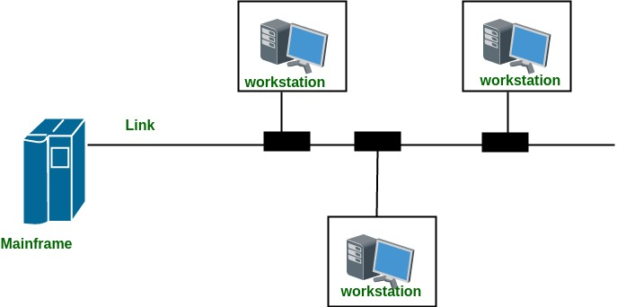
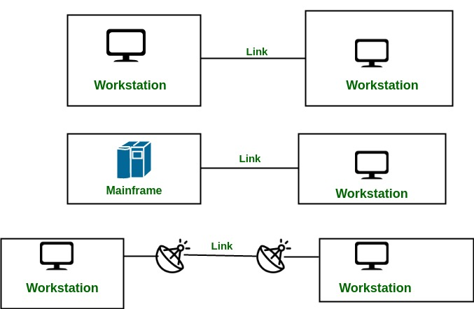

Slide 21
Network Types/Topologies
Types of Network Topology
The arrangement of a network that comprises nodes and connecting lines via sender and receiver is referred to as Network Topology. The various network topologies are:
Mesh Topology
Star Topology
Bus Topology
Ring Topology
Hybrid Topology

Slide 22
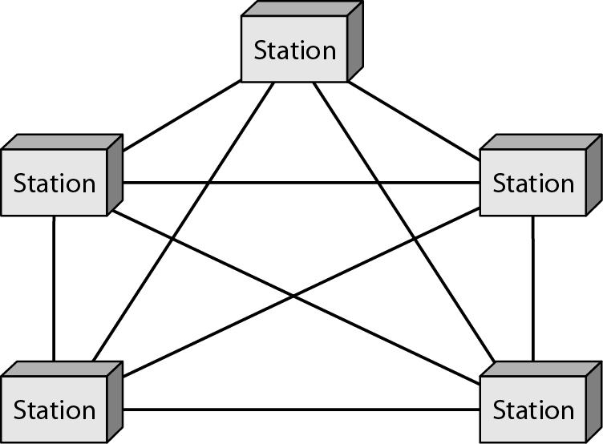
Mesh Topology
In a mesh topology, every device is connected to another device via a particular channel.
Connection of telephone regional offices.
links

Slide 23
A common example of mesh topology is the internet backbone, where various internet service providers are connected to each other via dedicated channels.
This topology is also used in military communication systems and aircraft navigation systems.

Slide 24
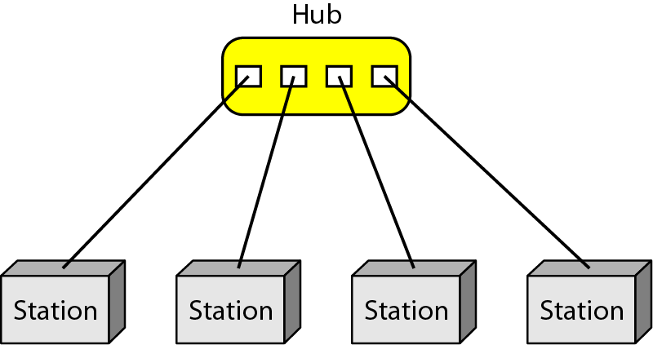
Star Topology
In Star Topology, all the devices are connected to a single hub through a cable.
High speed LAN
cable

Slide 25
If the concentrator (hub) on which the whole topology relies fails, the whole system will crash down.
The cost of installation is high.
Performance is based on the single concentrator i.e. hub.
A common example of star topology is a local area network (LAN) in an office where all computers are connected to a central hub.
This topology is also used in wireless networks where all devices are connected to a wireless access point.

Slide 26
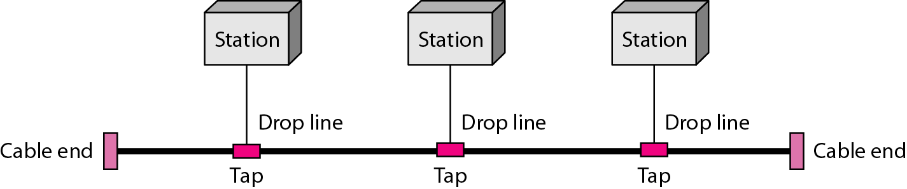
Bus Topology
Bus Topology is a network type in which every computer and network device is connected to a single cable. It is bi-directional.
Early Ethernet
If N devices are connected to each other in a bus topology, then the number of cables required to connect them is 1, known as backbone cable, and N drop lines are required.

Slide 27
If the network traffic is heavy, it increases collisions in the network. To avoid this, various protocols are used in the MAC layer known as Pure Aloha, Slotted Aloha, CSMA/CD, etc.
Adding new devices to the network would slow down networks.
Security is very low.
A common example of bus topology is the Ethernet LAN, where all devices are connected to a single coaxial cable or twisted pair cable.
This topology is also used in cable television networks.

Slide 28
In a bus network topology, "tap" and "drop" lines are terms used to describe how devices are connected to the main communication line or bus.
Tap Line: A tap line is a connection point along the main bus where a device can be connected. When a device is connected to the tap line, it can send and receive data over the bus. Each device connected via a tap line taps into the main communication line to communicate with other devices on the network.
Drop Line: A drop line is a connection that branches off from the main bus line to connect a device to the network. A drop line typically connects a device to the main bus at a tap point. The drop line allows the device to communicate with other devices on the network by sending and receiving data over the main bus.

Slide 29
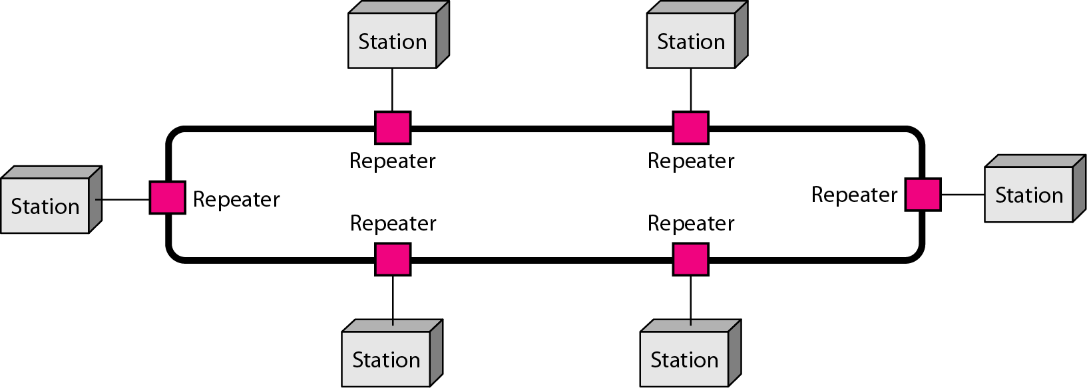
Ring Topology
In a Ring Topology, it forms a ring connecting devices with exactly two neighboring devices.
The data flows in one direction, i.e. it is unidirectional, but it can be made bidirectional by having 2 connections between each Network Node, it is called Dual Ring Topology.

Slide 30
In-Ring Topology, the Token Ring Passing protocol is used by the workstations to transmit the data.
The most common access method of ring topology is token passing.
Token passing: It is a network access method in which a token is passed from one node to another node.
Token: It is a frame that circulates around the network.
There are two types of token release techniques: Early token release releases the token just after transmitting the data and Delayed token release releases the token after the acknowledgment is received from the receiver.

Slide 31
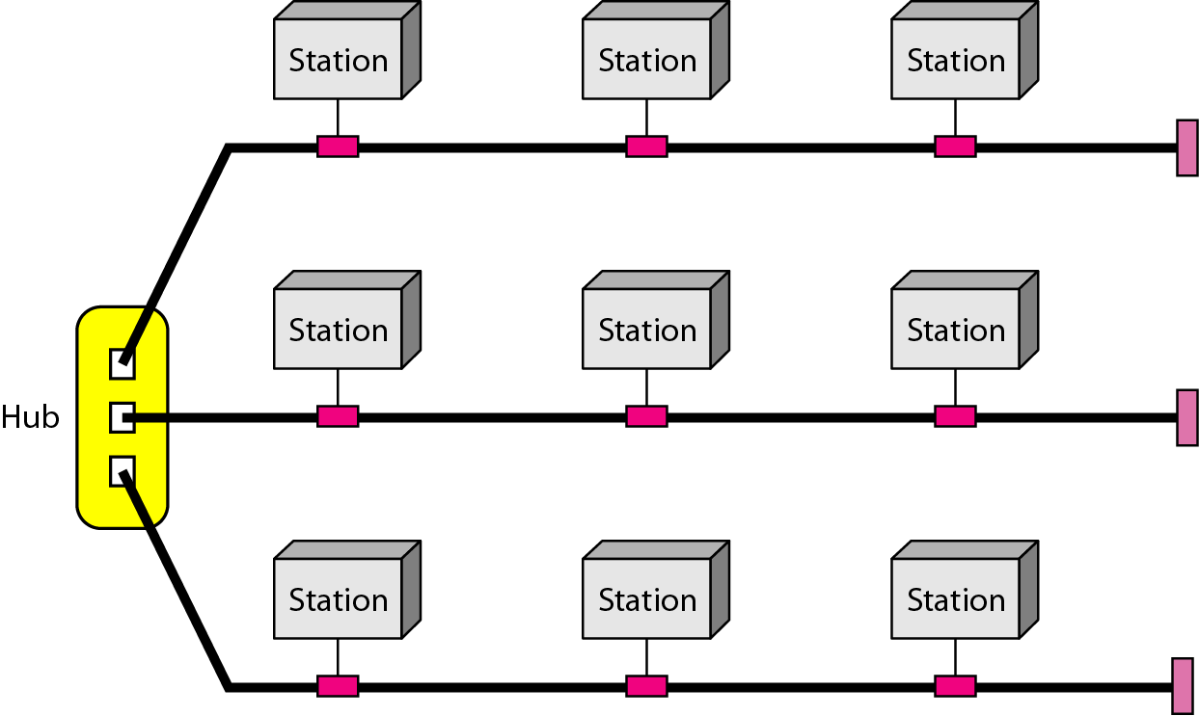
Hybrid Topology
Combination of two or more network topology

Slide 32
A common example of a hybrid topology is a university campus network. The network may have a backbone of a star topology, with each building connected to the backbone through a switch or router.
Within each building, there may be a bus or ring topology connecting the different rooms and offices.
The wireless access points also create a mesh topology for wireless devices.
This hybrid topology allows for efficient communication between different buildings while providing flexibility and redundancy within each building.

Slide 33
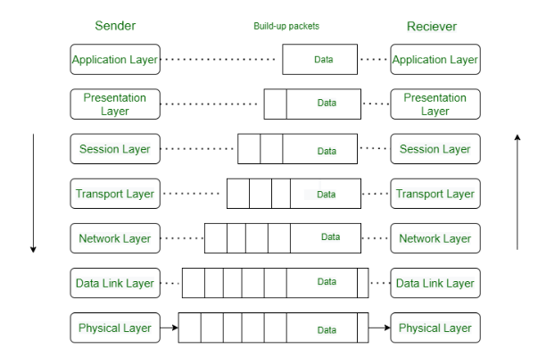
Reference Models: OSI
OSI stands for Open Systems Interconnection. It was developed by ISO – ‘International Organization for Standardization’.

Slide 34
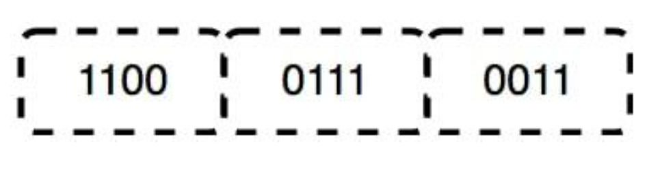
Physical Layer – Layer 1
The lowest layer of the OSI reference model is the physical layer.
The physical layer contains information in the form of bits.
When receiving data, this layer will get the signal received and convert it into 0s and 1s and send them to the Data Link layer, which will put the frame back together.

Slide 35
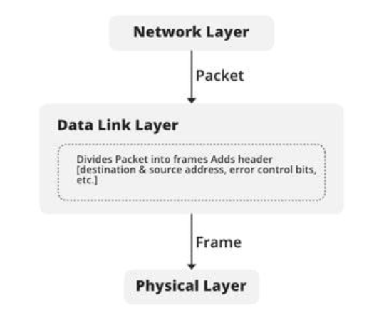
Data Link Layer (DLL) – Layer 2
The data link layer is responsible for the node-to-node delivery of the message.
The Data Link Layer is divided into two sublayers:
Logical Link Control (LLC)
Media Access Control (MAC)
Each device should have a unique MAC address
assigned by its vendor.
The logical addressing is the IP address
assigned to interfaces.

Slide 36
Network Layer – Layer 3
The network layer works for the transmission of data from one host to the other located in different networks. It also takes care of packet routing.
The sender & receiver’s IP addresses are placed in the header by the network layer.
Segment in the Network layer is referred to as Packet.
Network layer is implemented by networking devices such as routers and switches.

Slide 37
Transport Layer – Layer 4
The transport layer provides services to the application layer and takes services from the network layer.
The data in the transport layer is referred to as Segments.
It is responsible for the End to End Delivery of the complete message.
Services Provided by Transport Layer
Connection-Oriented Service
Connectionless Service

Slide 38
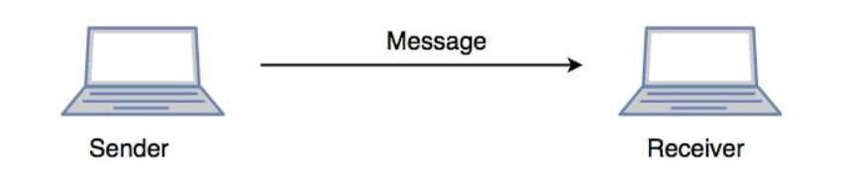
Session Layer – Layer 5
This layer is responsible for the establishment of connection, maintenance of sessions, and authentication, and also ensures security.
for Example:-
Let us consider a scenario where a user wants to send a message through some Messenger application running in his browser. The “Messenger” here acts as the application layer which provides the user with an interface to create the data. This message or so-called Data is compressed, encrypted (if any secure data), and converted into bits (0’s and 1’s) so that it can be transmitted.

Slide 39
Presentation Layer – Layer 6
The presentation layer is also called the Translation layer. The data from the application layer is extracted here and manipulated as per the required format to transmit over the network.
Translation: For example, ASCII to EBCDIC.
Encryption/ Decryption: Signals

Slide 40
Application Layer – Layer 7
At the very top of the OSI Reference Model stack of layers, we find the Application layer which is implemented by the network applications.
These applications produce the data, which has to be transferred over the network.
The application Layer is also called Desktop Layer.

Slide 41
The functions of the seven layers
The physical layer is concerned with transmitting raw bits over a communication channel
The data link layer performs flow control and also transforms a raw
transmission facility into a line that appears error free (ARQ)
The network layer controls the operation of the subnet, e.g. routing, flow control, internetworking.
The transport layer performs assembling and disassembling, isolates the upper layers from the changes in the network hardware, and determines the type of services

Slide 42
The session layer establishes sessions (dialog control, …)
The presentation layer is concerned with the syntax and semantics
The application layer contains a variety of commonly used protocols (e.g. HyperText Transfer Protocol for WWW, file transfer, e-mail)

Slide 43
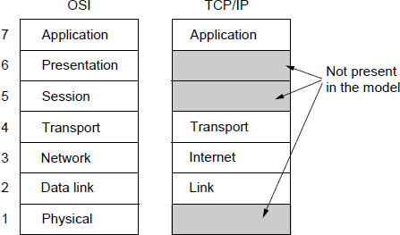
The OSI-TCP/IP Reference Model
The TCP/IP reference model

Slide 44
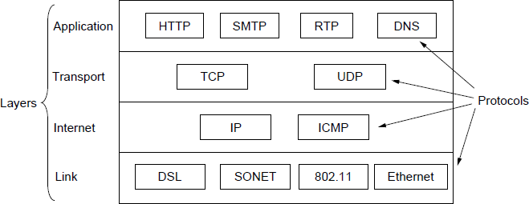
The TCP/IP Reference Model
The TCP/IP reference model with some protocols

Slide 45
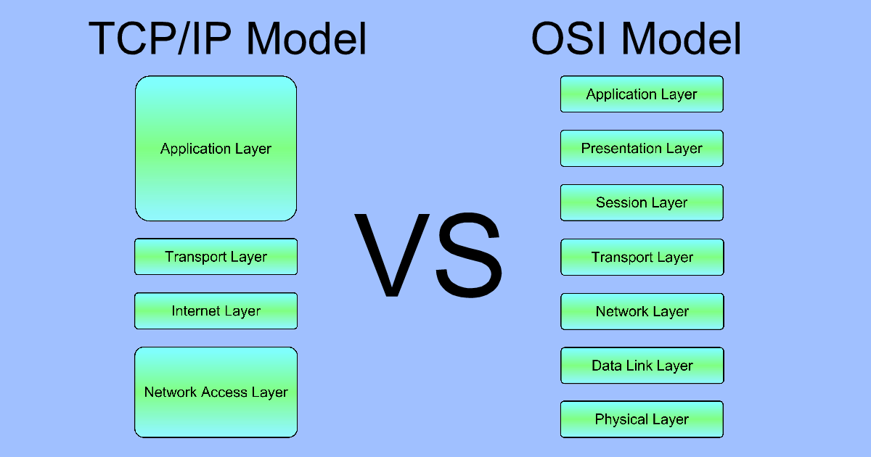

Slide 46
The TCP/IP model was developed prior to the OSI model.
The TCP/IP model is not exactly similar to the OSI model.
The TCP/IP model consists of four layers.
Helps establish a connection between different types of computers.
Works independently of the OS.
Supports many routing protocols.
Uses client-server architecture.
Can be operated independently.

Slide 47
Comparison of OSI & TCP/IP
OSI has 7 layers whereas TCP/IP has 4 layers.
The OSI Model is a logical and conceptual model that defines network communication used by systems open to interconnection and communication with other systems. On the other hand, TCP/IP helps you to determine how a specific computer should be connected to the internet and how you can be transmitted between them.
OSI header is 5 bytes whereas TCP/IP header size is 20 bytes.
OSI refers to Open Systems Interconnection whereas TCP/IP refers to Transmission Control Protocol.

Slide 48
OSI follows a vertical approach whereas TCP/IP follows a horizontal approach.
OSI model, the transport layer, is only connection-oriented whereas the TCP/IP model is both connection-oriented and connectionless.
OSI model is developed by ISO whereas TCP Model is developed by ARPANET.
OSI model helps you to standardize router, switch, motherboard, and other hardware whereas TCP/IP helps you to establish a connection between different types of computers.

Slide 49
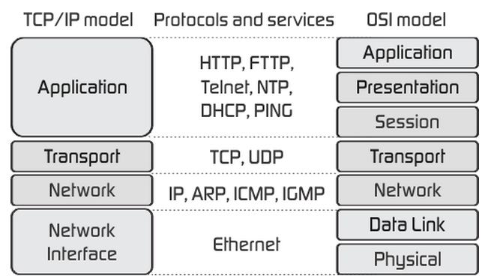

Slide 50
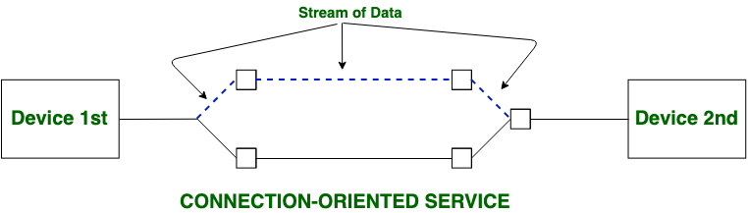
Connection-oriented
Both Connection-oriented service and Connection-less service are used for the connection establishment between two or more two devices.
These services are offered by the network layer.

Slide 51
Connection-oriented service is related to the telephone system. It includes connection establishment and connection termination.
In a connection-oriented service, the Handshake method is used to establish the connection between sender and receiver.

Slide 52
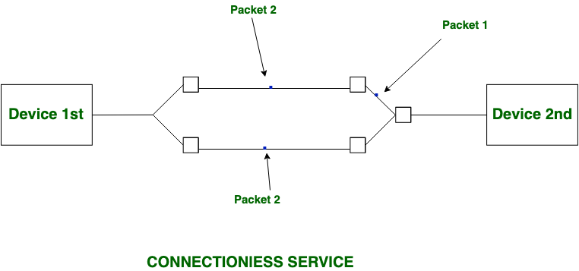
Connection-less Services
Connection-less service is related to the postal system. It does not include any connection establishment and connection termination.
Connection-less Service does not give a guarantee of reliability. In this, Packets do not follow the same path to reach their destination.

Slide 53
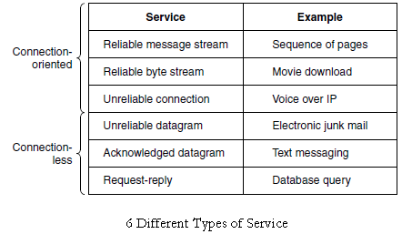

Slide 54
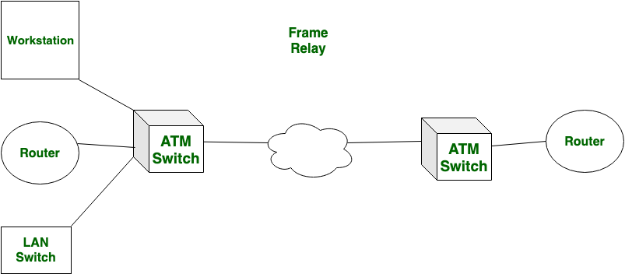
ATM
Asynchronous Transmission Mode (ATM):
ATM has mounted packet size.
It provides the information speed of a hundred and fifty five.5 Mbps or 622 Mbps.
ATM provides error management and flow management. it’s a decent reliable than frame relay.

Slide 55
Definition of ATM
Benefits of ATM
ATM Technology
ATM Services
ATM Standards
Voice over ATM
Video over ATM
ATM Applications

Slide 56
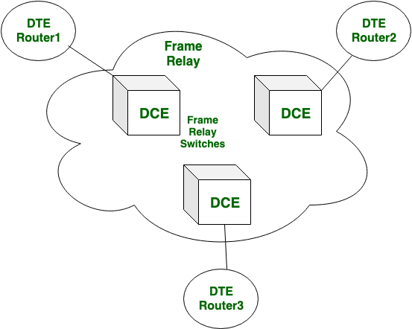
Frame Relay
Frame Relay is that the transmission mode during which information is transferred through electric circuit layer, within the style of packets.
It provides the information speed from sixty four Kbps to forty five Mbps.
Frame relay has variable packet size.
It doesn’t give error management and flow management. The responsibility of frame relay is a smaller amount.

Slide 57
Frame Relay
Frame Relay is that the transmission mode during which information is transferred through electric circuit layer, within the style of packets.
It provides the information speed from sixty four Kbps to forty five Mbps.
Frame relay has variable packet size.
It doesn’t give error management and flow management. The responsibility of frame relay is a smaller amount.

Slide 58
Integrated Services Digital Network (ISDN)
ISDN is a circuit-switched telephone network system, but it also provides access to packet-switched networks that allows digital transmission of voice and data.
Before Integrated Services Digital Network (ISDN), the telephone system was seen as a way to transmit voice, with some special services available for data.
The main feature of ISDN is that it can integrate speech and data on the same lines, which were not available in the classic telephone system.

Slide 59
ISDN Interfaces:
The following are the interfaces of ISDN:
Basic Rate Interface (BRI) –
There are two data-bearing channels (‘B’ channels) and one signaling channel (‘D’ channel).
Primary Rate Interface (PRI) –
Primary Rate Interface service consists of a D channel.
Broadband-ISDN (B-ISDN) –
B-ISDN relies mainly on the evolution of fiber optics.

Slide 60
ISDN Services:
ISDN provides a fully integrated digital service to users. These services fall into 3 categories- bearer services, teleservices, and supplementary services.
Bearer Services –
Transfer of information (voice, data, and video)
Teleservices
Supplementary Service –
Additional functionality to the bearer services and teleservices are provided by supplementary services. Reverse charging, call waiting, and message handling

Slide 61
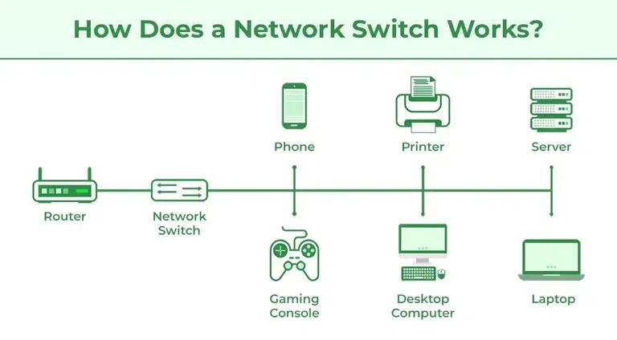
Switching
A switch is a hardware device in a network that connects other devices, like computers and servers. It helps multiple devices share a network without their data interfering with each other.
Switching is the process of transferring data packets from one device to another in a network, or from one network to another, using specific devices called switches.

Slide 62
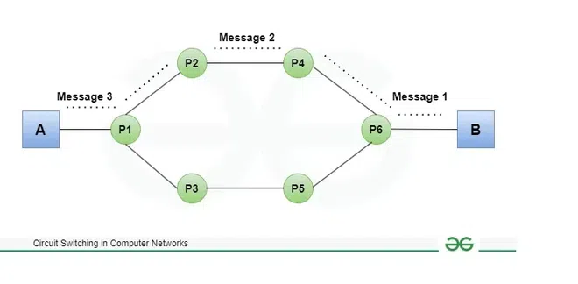
What is Circuit Switching?
Circuit Switching is a type of switching, in which a connection is established between the source and destination beforehand.
This connection receives the complete bandwidth of the network until the data is transferred completely.
Data can be transmitted without any delays once the circuit is established.

Slide 63
Virtual Circuits and Datagram Networks
Virtual Circuits
It is connection-oriented, meaning that there is a reservation of resources like buffers, CPU, bandwidth, etc. for the time in which the newly set VC is going to be used by a data transfer session.
Virtual Circuit Switching ensures that all packets successfully reach the Destination. No packet will be discarded due to the unavailability of resources.
Types of Virtual Circuit
Permanent Virtual Circuits(PVC)
Switched Virtual circuits (SVCs)

Slide 64
Datagram Networks
It is a connection-less service.
There is no need for reservation of resources as there is no dedicated path for a connection session.
Datagram networks are not as reliable as Virtual Circuits.
The major drawback of Datagram Packet switching is that a packet can only be forwarded if resources such as the buffer, CPU, and bandwidth are available. Otherwise, the packet will be discarded.

Slide 65
Question : Identify the different devices used in Network connection in College campus.(Connecting Devices)

Slide 66
Router
Switch
Access Points (APs)
Firewall
Gateway
Modem
Load Balancer
Network Hubs
Network Bridges
Network Security Appliances
Ethernet Cables and Fiber Optic Cables
Network Management Systems (NMS)

